Slide 1



Slide 2
I.SAMPREETH(9920004385) R.NITHIN(9920004422) T.SAI PRATHAP(9920004450) S.PRADEERP(9920004403)

Slide 3

Ideology behind the project
1) To design such system that can detect crop disease and accurately.
2) Insecticides for respective pest and disease.
3) To provide remedy for the disease that is detected.

Slide 4
Why we choosen this project :
1.The study of plant diseases is important as they cause loss to the plant as well as plant produce.
2.Plant diseases are well known to reduce the food available to humans by ultimately interfering with crop yields.
3.So , it is necessary to indentify and solve the plant diseases

Slide 5
ABSTRACT
Identification of the plant diseases is the key to prevent the losses in the yield and quantity of the agricultural product. The studies of the plant diseases mean the studies of visually observable patterns seen on the plant. Health monitoring and disease detection on plant is very critical for sustainable agriculture. It is very difficult to monitor the plant diseases manually. It requires tremendous amount of work, expertise in the plant diseases, and also require the excessive processing time. Hence, image processing is used for the detection of plant diseases by capturing the images of the leaves and comparing it with the data sets. The data set consist of different plant in the image format.

Slide 6

INTRODUCTION
Plant disease identification by visual way is more laborious task and at the same time less accurate and can be done only in limited areas.
Whereas if automatic prediction technique is used it will take less efforts, less time and more accurately. In plants, some general diseases are brown and yellow sand late scorch, and other fungal, viral and bacterial diseases.

Slide 7
PACKAGES USED
NUMPY
PANDAS
KERAS – PREPROCESSING
TENSORFLOW
FLASK
CNN

Slide 8
CNN MODEL
A convolutional neural network, or CNN, is a deep learning neural network sketched for processing structured arrays of data such as portrayals.
CNN are very satisfactory at picking up on design in the input image, such as lines, gradients, circles, or even eyes and faces.
This characteristic that makes convolutional neural network so robust for computer vision.
CNN can run directly on a underdone image and do not need any preprocessing.
The construction of a convolutional neural network is a multi-layered feed-forward neural
network, made by assembling many unseen layers on top of each other in a particular order.
It is the sequential design that give permission to CNN to learn hierarchical attributes.

Slide 9

CNN Model

Slide 10
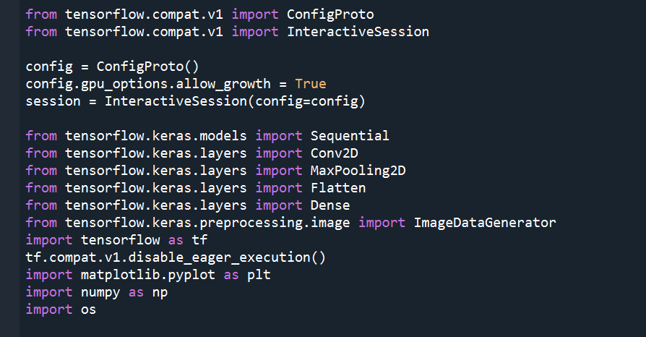
IMPLEMENTATION
LIBRARIES

Slide 11
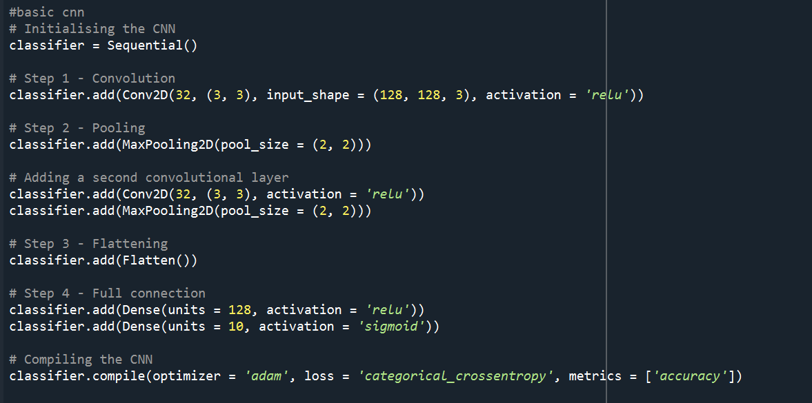
CNN DESIGN :

Slide 12
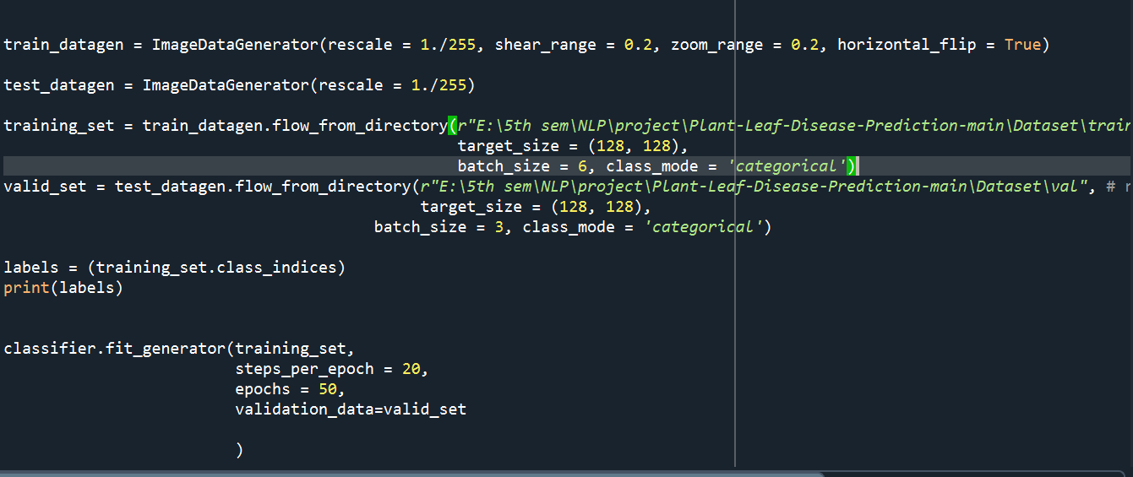
TRAINING MODEL

Slide 13
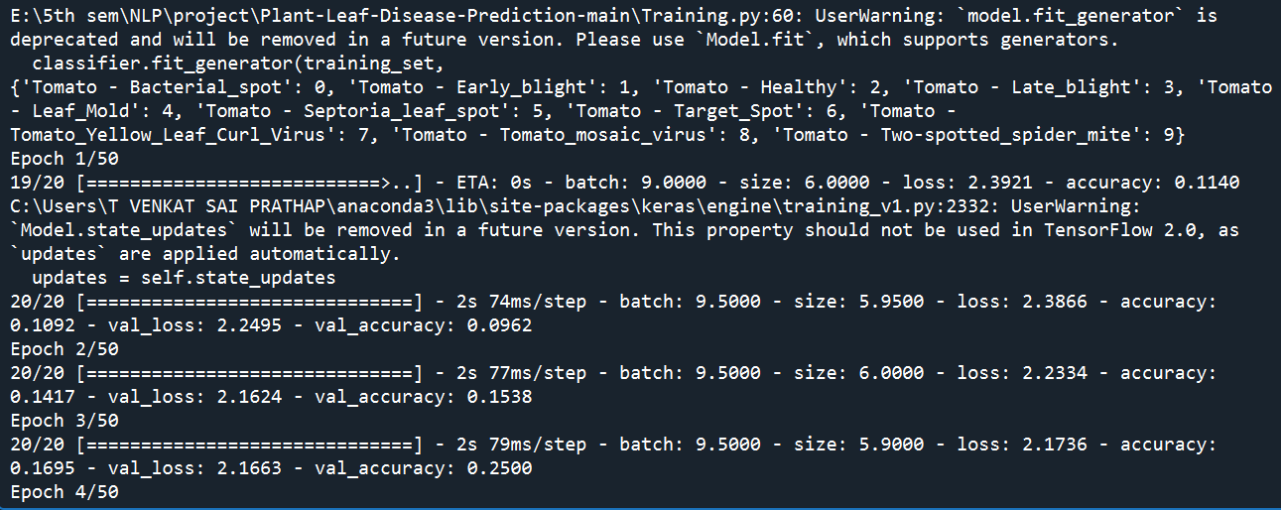
Out put

Slide 14
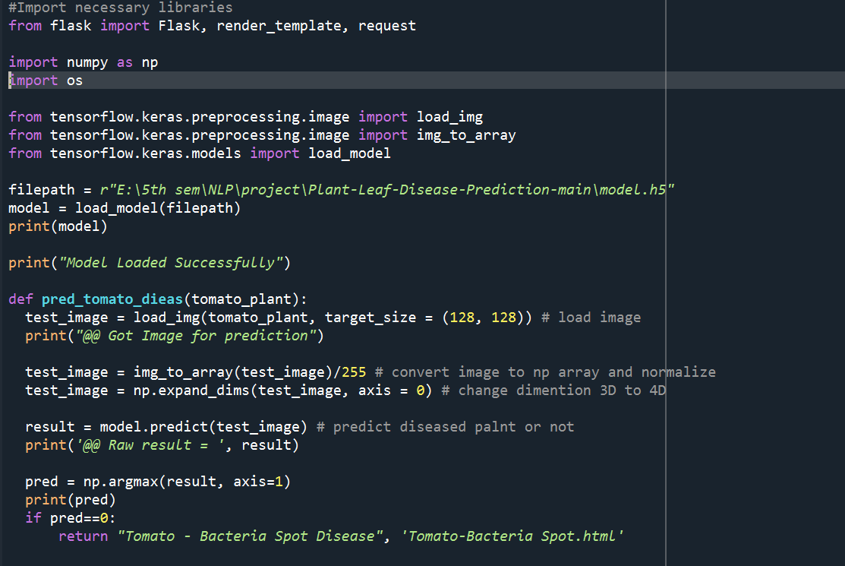
WEB APP USING FLASK

Slide 15
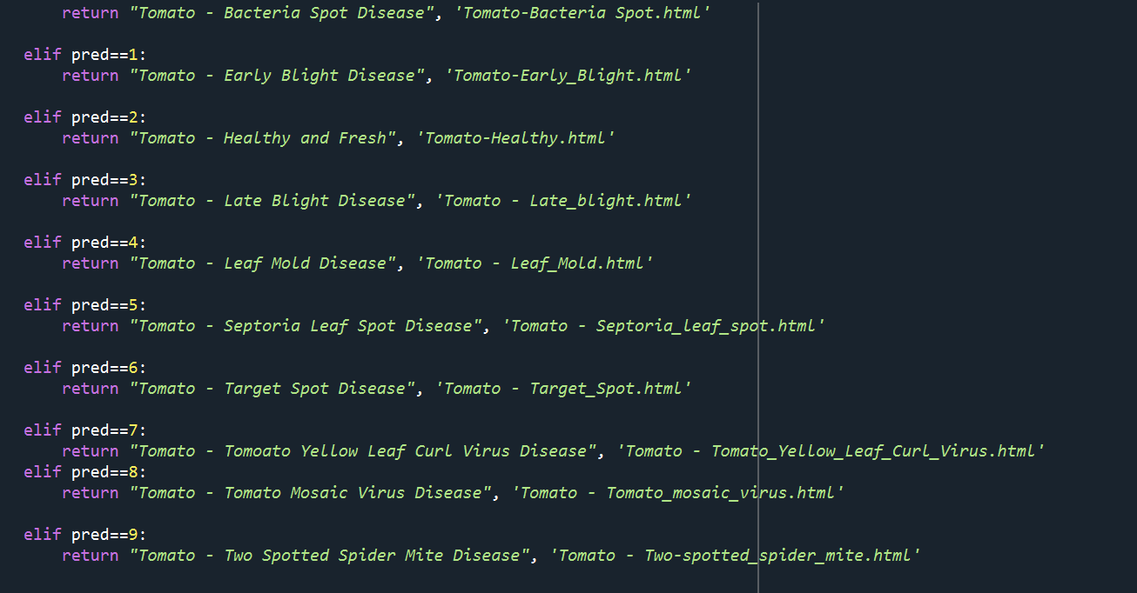

Slide 16
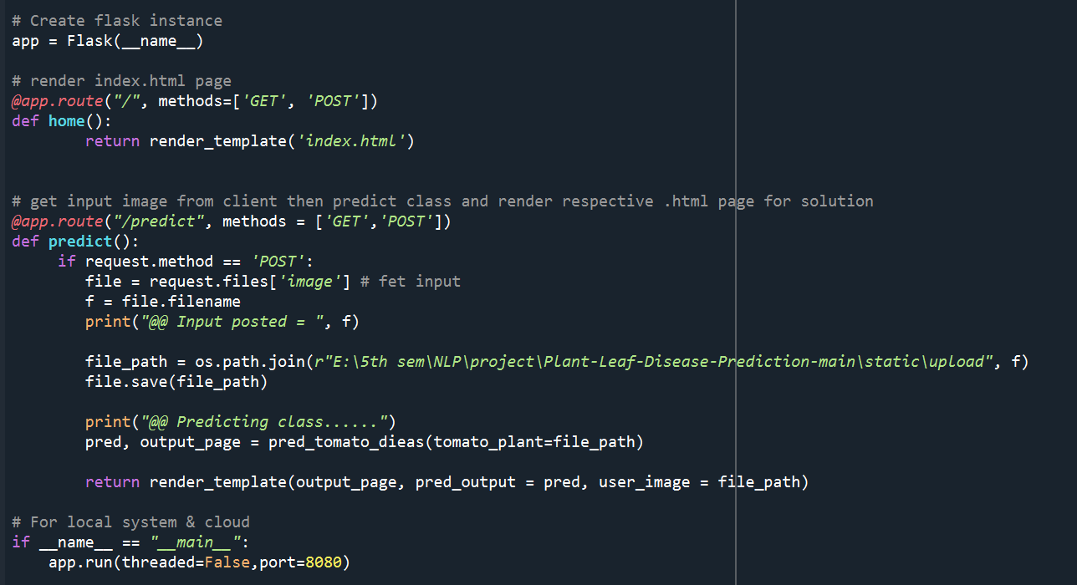

Slide 17
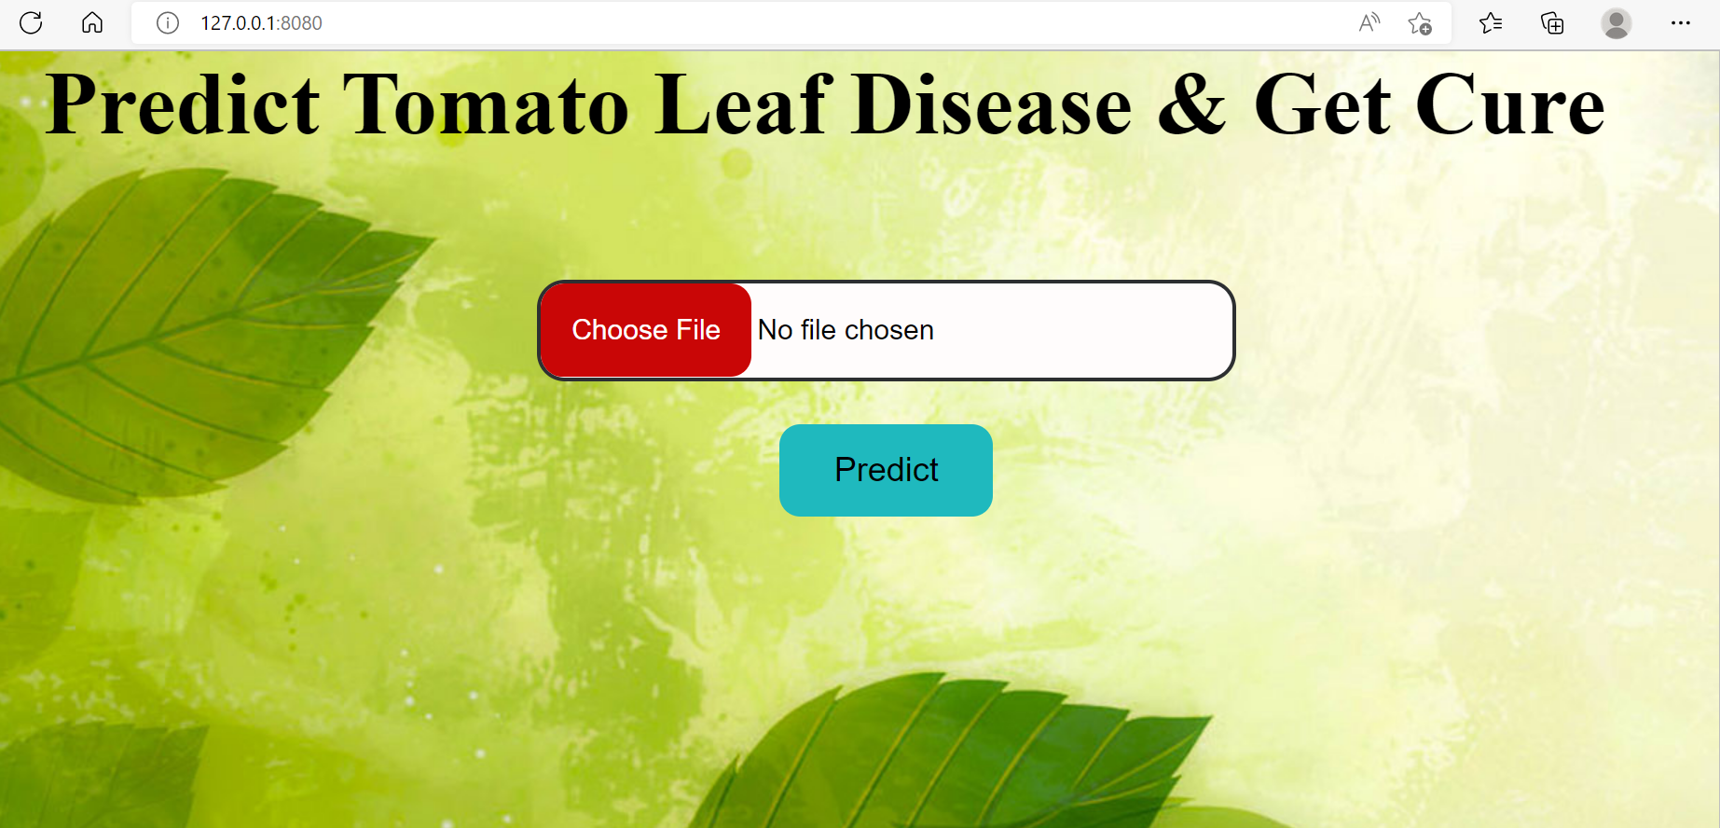
Out put:

Slide 18
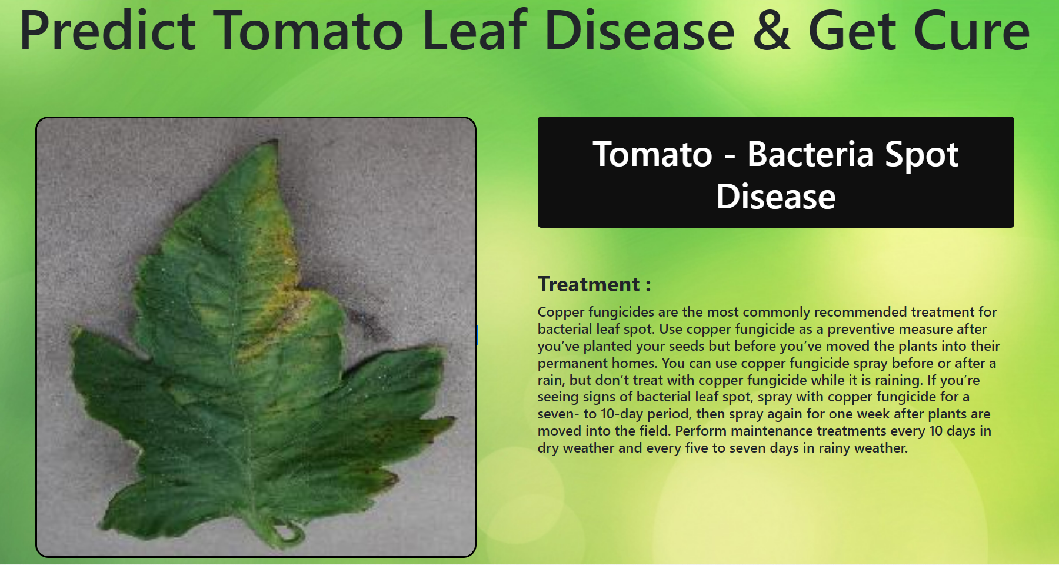

Slide 19
CONCLUSION
The application built for the identification of disease affected plants and healthy plants is done and this proposed work is focuses on the accuracy values during the real field conditions, and this work is implemented by having tamato plant disease images. Overall this work is implemented from scratch and produces a decent accuracy.

Slide 20

THANK YOU

